Slide 1
Interactive Maps
Possible Approaches and preliminary design outline
Research Description

Slide 2
Possible Approaches
Possible Approaches:
Use a combination of user input and pre-existing data to determine street typologies and stress levels.
Utilize open-source mapping data to create an accurate and up-to-date map of Kalamazoo and Portage.
Consider implementing machine learning algorithms to improve the efficiency and accuracy of the routing algorithm.
Use an agile development methodology to iterate and improve the app based on user feedback.

Slide 3
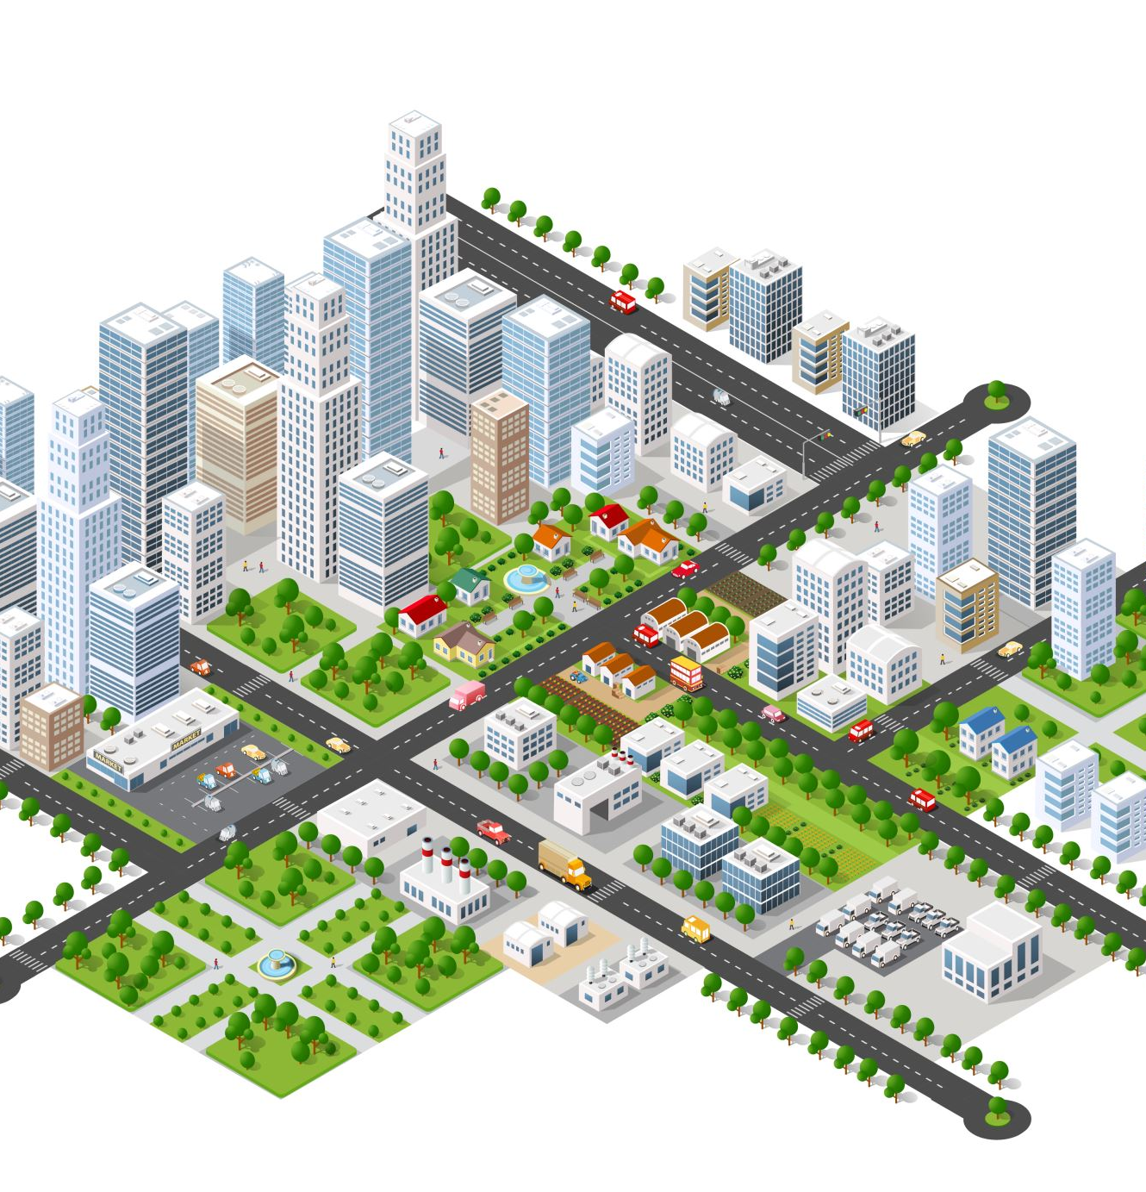
Research Description
Research Description: To develop a custom bike routing app for the city of Kalamazoo and Portage, several key research areas need to be explored. These include:
Understanding the existing bike infrastructure and street typologies in the area, as well as any ongoing or planned improvements to the infrastructure.
Examining the needs and preferences of potential users of the app, including factors such as safety concerns, convenience, and desired features.
Identifying and evaluating existing routing algorithms and data sources, including Dijkstra's Algorithm and open-source mapping data, to determine the best approach for the app.
Investigating the use of machine learning algorithms, such as decision trees or neural networks, to improve the accuracy and efficiency of the routing algorithm.
Analyzing the potential impact of the app on promoting active transportation and improving bike infrastructure in Kalamazoo and Portage.
Considering the technical requirements for developing and maintaining the app, including server infrastructure, web development frameworks, and software libraries.

Slide 4
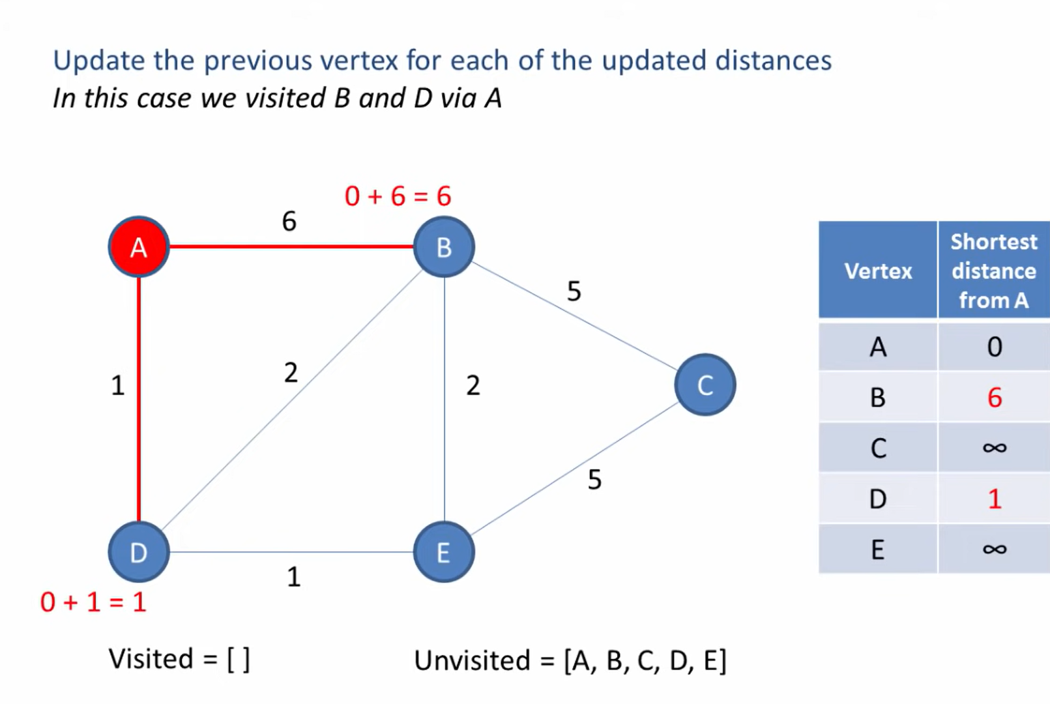
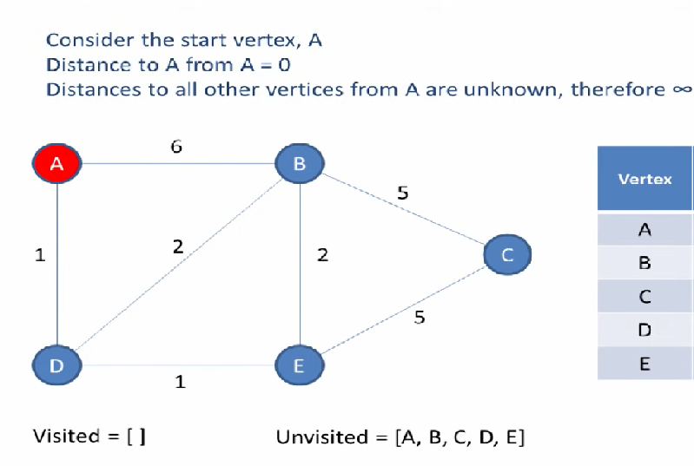
Diagram

Slide 5
